Slide 1
Lecture 08
Bill Perry

Slide 2
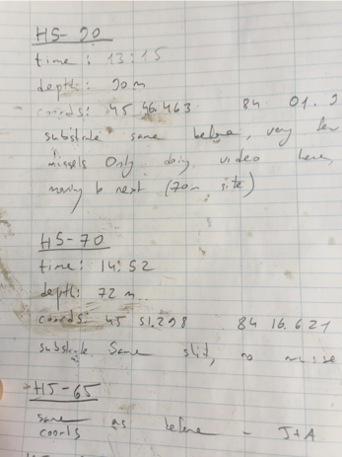
Lecture 7 Review
Covered
What are the assumptions again and how do you assess them
What to do when assumptions fail
Robust tests
Rank-based tests
Permutation tests

Slide 3
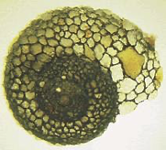
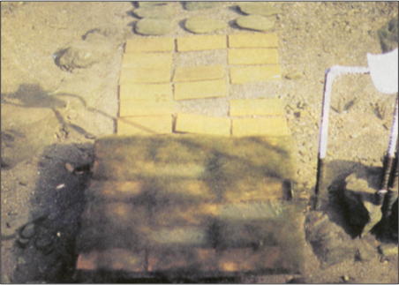
Lecture 8 Overview
Today we’ll cover:
Study design
Causality in ecology
Experimental design:
Replication, controls, randomization, independence
Sampling in field studies
Power analysis: a priori and post hoc
Study design and analysis
Lamberti and Resh 1983

Slide 4
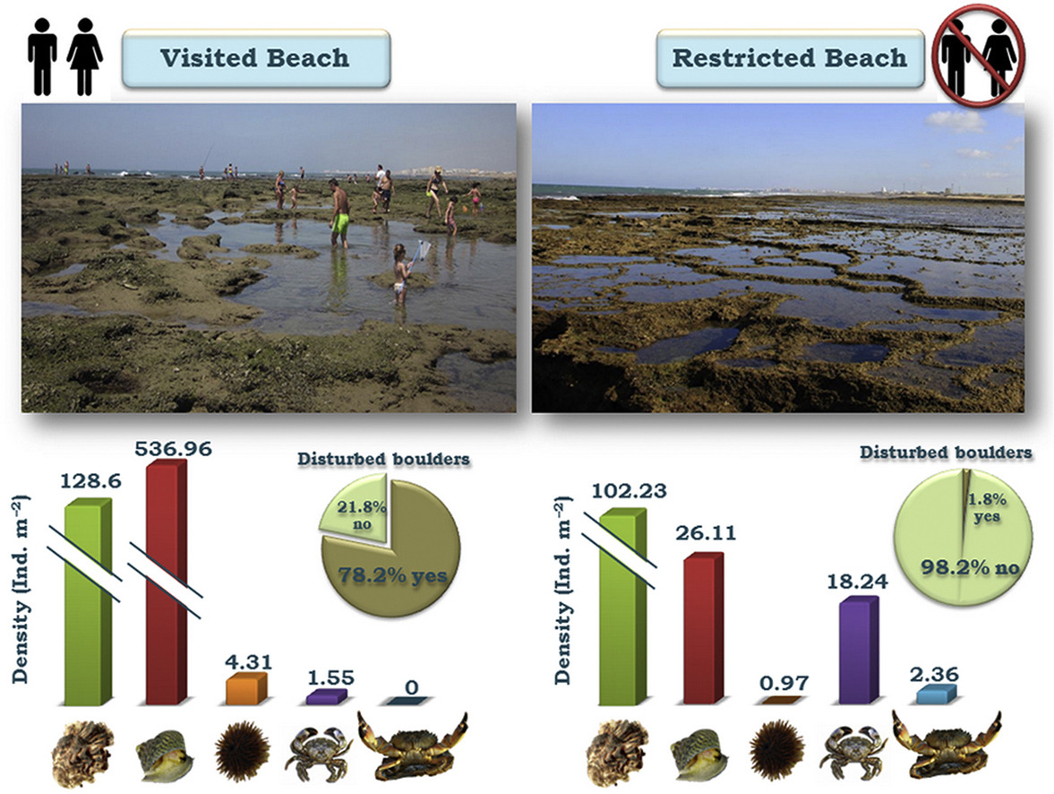
Study Design
Data analysis has close links to study design
Statistics cannot save a poorly designed study!
Key question: what is your research question?
Common scientific questions:
Spatial/temporal patterns in variable Y?
Effect of factor X on variable Y?
Are values of variable Y consistent with hypothesis H?
What is the best estimate of parameter θ?

Slide 5
Activity 1: Formulating Research Questions
Take 5 minutes to write down 2-3 potential research questions about pine trees on our campus.
Be as specific as possible about what you would measure.
Share with a partner and discuss which questions would be easier to address experimentally.

Slide 6
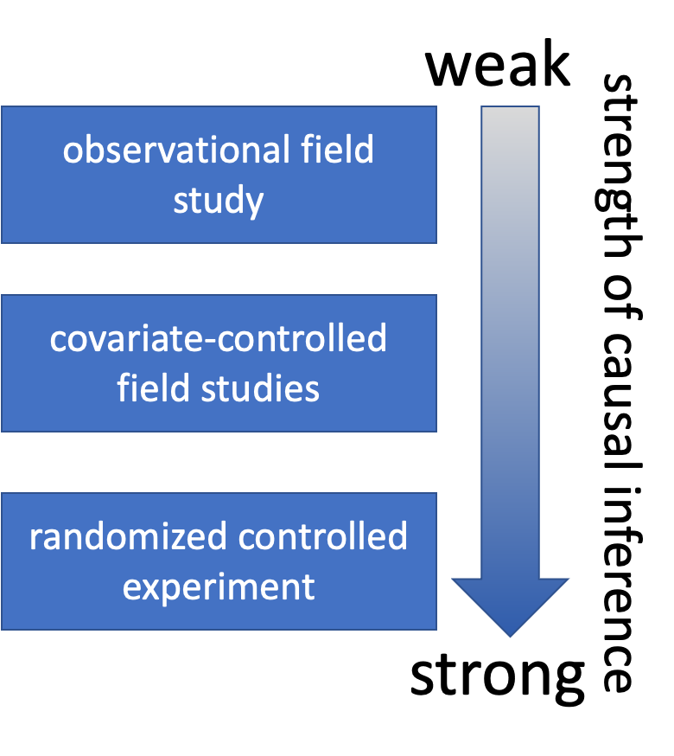
Causality in Ecology
Common question: what is the cause of Y?
Causality is challenging; modern statistics lacks clear language for causality
Strength of causal inference varies with study design
Key factor: control of confounding variables

Slide 7

Causality in Ecology
Common question: what is the cause of Y?
Causality is challenging; modern statistics lacks clear language for causality
Strength of causal inference varies with study design
Key factor: control of confounding variables

Slide 8
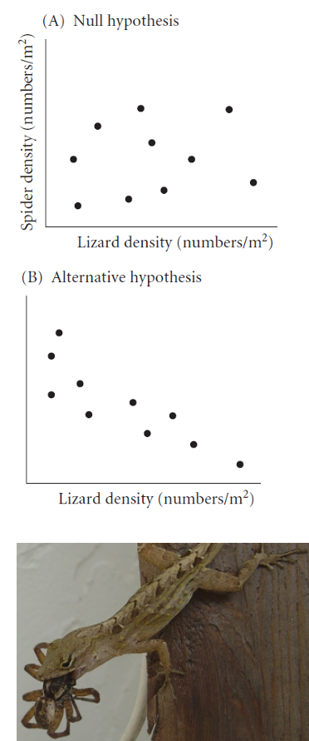
Causality Example
Example: Spider and lizard populations on small islands
Hypothesis: On small islands, lizard predation controls spider density
We’re interested in causality. How do we get there?

Slide 9
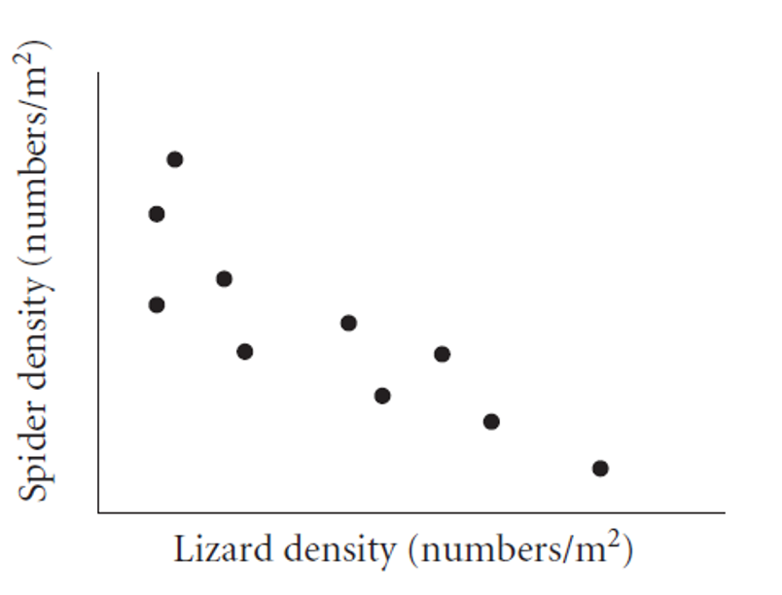
Natural Experiments
Not really experiments at all!
Utilizes natural variation in predictor variable
E.g., survey plots across natural gradient of lizard density
Potential Problems: -
Cannot determine direction of cause ↔ effect relationship
Uncontrolled variables may affect results

Slide 10
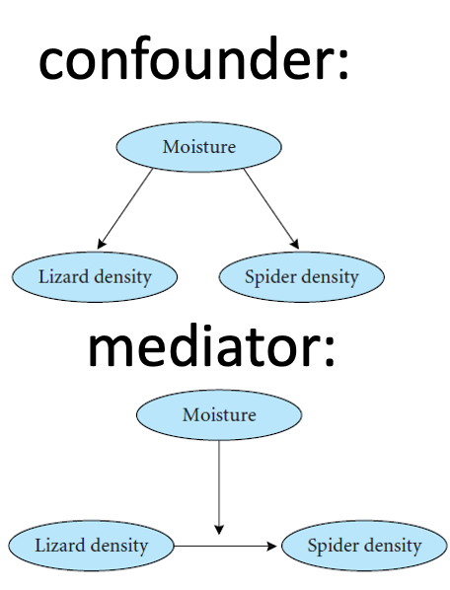
Strengthening Natural Experiments
Good design: Stronger inference from natural experiments
Reduce confounding (select plots similar in relevant ways)
Adjust for confounding (measure relevant covariates)
Identify and measure potential confounding variables

Slide 11
Activity 2: Pine Needle Natural Experiment Design
Suppose we want to investigate whether wind exposure affects pine needle length across our campus. We decide to pick exposed sheltered locations. What sort of design would we conduct?
# Let's simulate some pine needle data from exposed and sheltered locations exposed_locations <- data.frame( location = paste0("E", 1:5), wind = "exposed", length_mm = rnorm(5*10, mean = 75, sd = 10), tree_id = rep(1:5, each = 10) ) sheltered_locations <- data.frame( location = paste0("S", 1:5), wind = "sheltered", length_mm = rnorm(5*10, mean = 90, sd = 12), tree_id = rep(6:10, each = 10) ) fake_pine_data <- rbind(exposed_locations, sheltered_locations) # View the data fake_pine_data %>% ggplot(aes(wind, length_mm, color = wind)) + geom_boxplot()
In small groups, discuss:
What confounding variables might affect this natural experiment?
How would you design a study to reduce these confounding effects?
What data would you collect besides needle length?

Slide 12
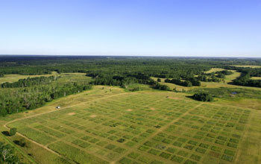
Manipulative Experiments
Experimenter directly manipulates predictor variable and measures response
Randomized, controlled trials: gold standard
Challenges:
Often restricted to small “plots”; scale-replication trade-off
Often restricted to small, short-lived organisms
Often limited to small number of treatments; treatment-replication trade-off
Still requires careful control of confounding!

Slide 13
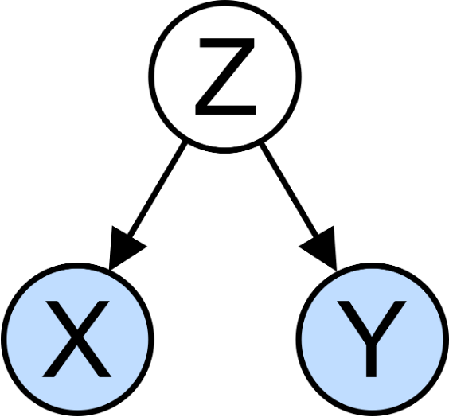
Experimental Design Principles
Main problem of study design & interpretation: confounding
Is the result due to X or other factors?
Good study design seeks to eliminate confounding through:
Replication
Randomization
Controls
Independence

Slide 14
Replication
Replication is important because:
Ecological systems are variable
Need estimate of variability for many statistical methods
Without appropriate replication: Is the difference due to manipulation or something else?
Replication must be on the appropriate scale: match scale of replication to population of interest, otherwise run into pseudoreplication (Hurlbert)

Slide 15
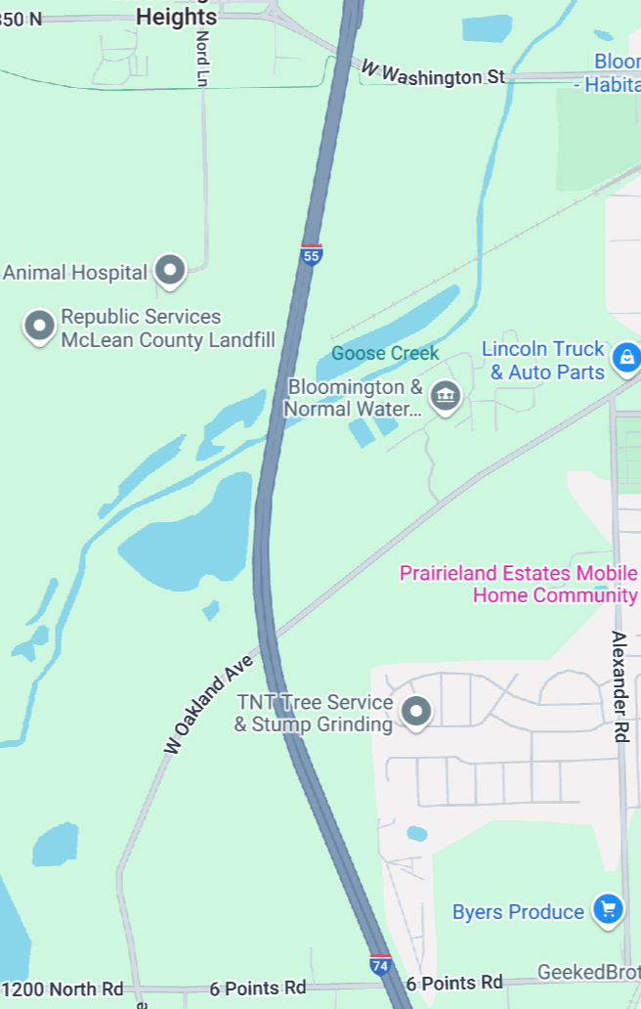
Replication Examples
Example 1: Effects of forest fire on soil invertebrate diversity
Replicate samples from burnt and unburnt parts of a single forest
What hypothesis is this design addressing?
Example 2: Effects of copper on barnacle settling
2 aquaria (+Cu, control), 5 settling plates in each
Are settling plates replicates?
Example 3: Effects of sewage discharge on water quality
10 water samples above discharge, 10 below
Are samples replicates?

Slide 16
Consequences of Pseudoreplication
When you pseudoreplicate, you:
Underestimate variability
Increase type I error rate
Replicates must be on scale appropriate to population (& hypothesis!) of interest:
Different burnt/unburnt forest areas
Different aquaria
Different plants and streams

Slide 17
Activity 3: Identifying True Replication
For each scenario below, identify whether there is true replication or pseudoreplication:
Testing soil pH effects on pine seedling growth by using one large pot with acidic soil and one with basic soil, with 10 seedlings in each pot
Testing the effect of a fertilizer on pine growth by applying it to 5 randomly selected trees in a stand, with 5 other trees as controls
Measuring air pollution effects by sampling needle damage in 3 pine stands near a factory and 3 stands 50km away
Discuss how you would redesign any pseudoreplicated studies.

Slide 18
When Replication is Difficult
What if replication is impossible/difficult/expensive?
Example: Effect of temperature on phytoplankton growth
4 chambers (5, 10, 15, 20°C), 10 beakers in each
Are beakers true replicates?
Possible solutions:
Rerun the experiment a few times, changing temperature of chambers
Try to account for all possible differences between chambers (light levels, humidity, contamination)

Slide 19
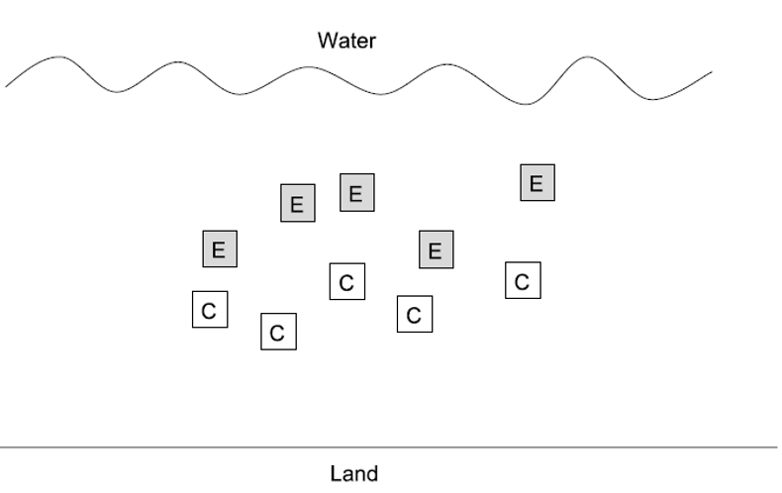
Randomization
Randomization helps deconfound “lurking” variables:
Attempts to equalize effects of confounders
Random sampling from population:
Experimental units should represent random sample from population of interest
Ensures unbiased population estimates and inference
E.g., animals in experiment are random subset of all animals that could have been used

Slide 20
Randomization in Practice
Allocation of experimental units to treatment/control:
Experimental units must have equal chance of being allocated to control or experimental group
Properly done by random number generation
Randomization is essential at two levels:
Random selection from population
Random assignment to treatments
# Example of randomization in R # Select 10 trees randomly from 100 possible trees all_trees <- 1:100 selected_trees <- sample(all_trees, 10) # Randomly assign 5 trees to treatment and 5 to control treatment_trees <- sample(selected_trees, 5) control_trees <- selected_trees[!selected_trees %in% treatment_trees] # Display results data.frame( Treatment = treatment_trees, Control = control_trees )
Treatment Control 1 18 49 2 74 100 3 65 47 4 24 71 5 25 89

Slide 21
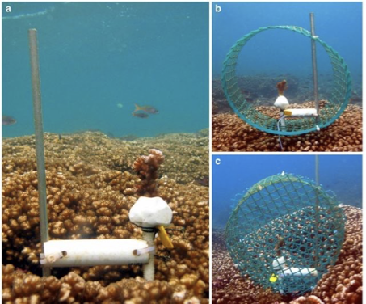
Controls
Key question: Is response due to manipulation/hypothesized mechanism or external factor?
Controls help address this question:
Experimental units treated exactly as the manipulated units, except no manipulation under investigation
Can be tricky to implement; requires careful thought
Examples:
In toxicology, controls and treatment groups must both be injected, but control does not receive the substance under study
Predator exclosures often produce “cage effects”
need two controls: a grazer/predator control and a “cage control”

Slide 22
Activity 4: Designing Controls for Pine Experiments
Work in small groups to design appropriate controls for each experiment:
Testing whether pine needle length is affected by a particular fertilizer
Testing whether pine needle density affects water retention during drought using enclosed branches
Testing whether sunlight exposure affects pine seedling growth using shade cloth
For each experiment, identify:
What would be appropriate controls?
What factors need to be controlled besides the main variable?
Could there be “cage effects” or similar issues to consider?

Slide 23
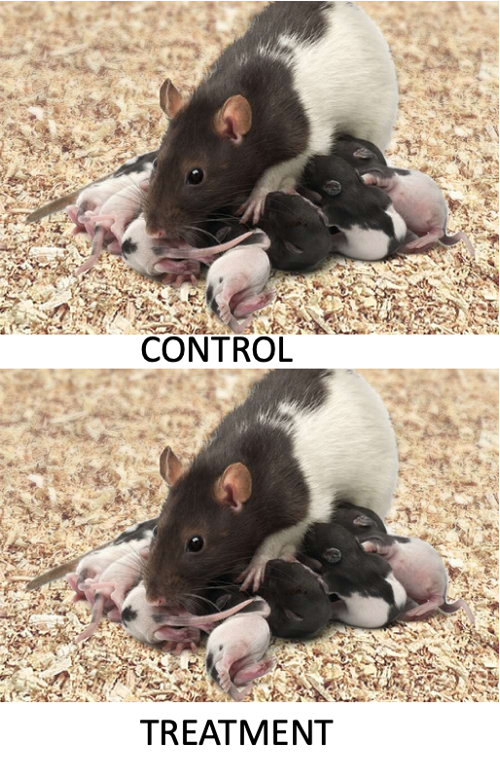
Independence
Independence of observations: assumption of many statistical methods
Events are independent if occurrence of one has no effect on occurrence of another
E.g., offspring of one mother for treatment, offspring of another for control
Temporal/spatial autocorrelation: violation of independence
Values of variables at certain place/time correlated with values at another place/time
“Everything is related to everything, but near things are more related than distant things”
Special methods to adjust for autocorrelation

Slide 24
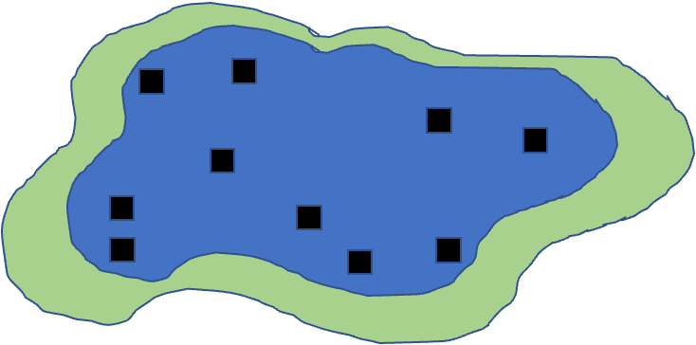
Sampling Design in Field Studies
Simple random design:
all individuals/sampling units have equal chance of being selected
Assign number to all possible units, select units using random number generator
Often tricky in ecology; haphazard is common alternative
Most population estimates and tests assume random sampling

Slide 25
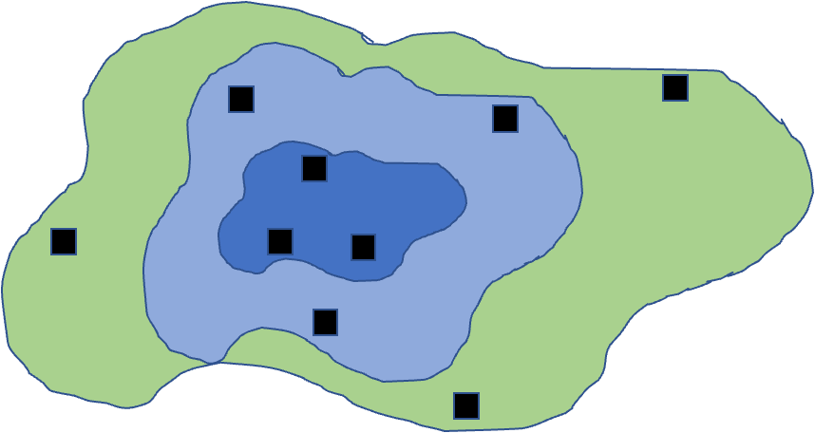
Sampling Design in Field Studies
Stratified designs: if there are distinct strata (groups) in population, may want to sample each independently
Samples collected from each stratum randomly, n proportional to “size” of stratum
Means and variances need to be estimated using different procedure; strata included in model

Slide 26
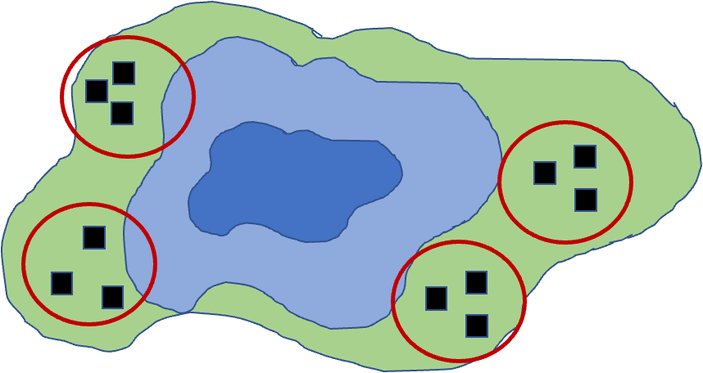
More Sampling Designs
Cluster designs:
focuses on sampling subunits nested in larger units
Used when other designs impractical (e.g., due to cost)
Mean calculation easy, modified procedure for variance
Nested ANOVA is often appropriate analytical method

Slide 27
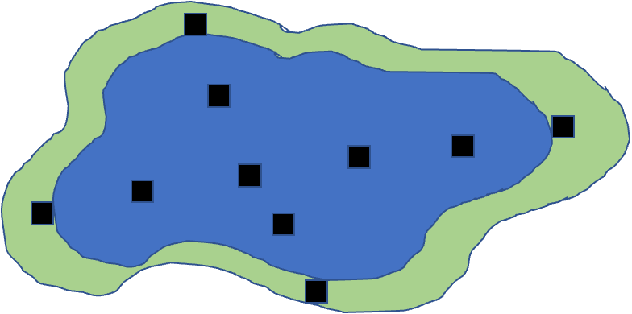
More Sampling Designs
Systematic designs:
sampling units evenly dispersed: “transect” sampling common in ecology
Used to determine changes along gradient
Risk: might coincide with some natural pattern

Slide 28
Activity 5: Field Sampling Pine Trees
Let’s consider sampling pine needles across campus:
# Let's create a campus map grid (simplified) campus_grid <- expand.grid(x = 1:10, y = 1:10) # Place "pine trees" clustered toward the north side (higher y values) set.seed(46) pine_locations <- data.frame( x = sample(1:10, 30, replace = TRUE), # Using rbeta to skew distribution toward higher y values # Alpha=1, Beta=3 creates right-skewed distribution, then scale to 1-10 range y = round(rbeta(30, 3, 1) * 9 + 1) ) # Plot the campus and trees ggplot() + geom_point(data = campus_grid, aes(x, y), color = "lightgrey", size = 0.5) + geom_point(data = pine_locations, aes(x, y), color = "darkgreen", size = 3) + theme_minimal() + labs(title = "Pine Tree Locations on Campus Grid (North Clustered)")
In groups of 3-4, design a sampling strategy to:
Estimate average needle length across campus (simple random sampling)
Compare needle lengths between north and south campus areas (stratified sampling)
Study how needle length changes with distance from the main road (systematic sampling)
For each strategy, describe:
How many samples you would take
Where you would take them
What additional variables you might measure

Slide 29
Power Analysis
Power is an important aspect of experimental design:
Low power → higher likelihood of type II error (1-β)
A study’s power tells us how likely we are to see an effect if one really exists
Can use power analysis:
Before experiment (a priori): how many samples do we need?
what effect size can we detect?
After experiment (post hoc): was finding of no effect due to lack of effect or poor design?
Power is a function of:
ES - Effect size
n - Sample size
sigma - standar deviation
α (significance level) - 0.05
$$\text{Power}∝\frac{ESα\sqrt{n}}{σ}$$

Slide 30
Apriori Power Analysis
Using power analysis to plan experiments:
Sample size calculation: how many samples will be needed?
Need to know: desired power, variability, significance level, effect size
Effect size calculation: what kind of effect can we find, given particular design?
Need to know: desired power, variability, significance level, n
Cohen’s d - standardized measure of effect size used in statistical analysis, particularly when comparing two means
0.2 = small effect
0.5 = medium effect
0.8 = large effect
Helps determine the practical significance of research findings, as opposed to just statistical significance (p-values). A Cohen’s d of 0.8 means that the difference between groups is large enough to be substantial in practical terms - specifically, it indicates that the means differ by 0.8 standard deviations.

Slide 31
A Priori Power Analysis
# A priori power analysis for t-test # How many samples needed per group? # Parameters effect_size <- 0.8 # Cohen's d significance <- 0.05 desired_power <- 0.8 # Calculate sample size needed pwr.t.test(d = effect_size, sig.level = significance, power = desired_power, type = "two.sample")
Two-sample t test power calculation n = 25.52458 d = 0.8 sig.level = 0.05 power = 0.8 alternative = two.sided NOTE: n is number in *each* group

Slide 32
Post Hoc Power Analysis
Imagine you did not reject null hypothesis - still worth publishing result?
Is non-significant result due to low power (poor design) or actual no-effect situation?
Have n and estimate of σ
Need to define effect size that wanted to detect
In return get estimate of experiment’s power
Cohen’s d is calculated as: d = (Mean1 - Mean2) / SD_pooled Where SD_pooled is the pooled standard deviation of both groups.
Can help convince reviewers that you are a good experimenter, but there really is no effect… please publish my non-significant finding!

Slide 33
Post Hoc Power Analysis
# Post hoc power analysis # If we had n = 20 per group # Parameters effect_size <- 0.5 # Medium effect size significance <- 0.05 sample_size <- 20 # per group # Calculate achieved power pwr.t.test(n = sample_size, d = effect_size, sig.level = 0.05, type = "two.sample")
Two-sample t test power calculation n = 20 d = 0.5 sig.level = 0.05 power = 0.337939 alternative = two.sided NOTE: n is number in *each* group
Activity 6: Power Analysis for Pine Needle Experiment
Let’s design a study to compare needle lengths between exposed and sheltered pine trees:
# Based on pilot data, we have these estimates: exposed_mean <- 75 # mm sheltered_mean <- 85 # mm pooled_sd <- 12 # mm # Calculate Cohen's d effect size effect_size <- abs(exposed_mean - sheltered_mean) / pooled_sd effect_size # A priori power analysis pwr.t.test(d = effect_size, sig.level = 0.05, power = 0.8, type = "two.sample")
Activity 6: Power Analysis for Pine Needle Experiment
Let’s design a study to compare needle lengths between exposed and sheltered pine trees:
# Visualize the power curve sample_sizes <- seq(5, 30, by = 1) power_values <- sapply(sample_sizes, function(n) { power <- pwr.t.test(n = n, d = effect_size, sig.level = 0.05, type = "two.sample")$power return(power) }) power_df <- data.frame( sample_size = sample_sizes, power = power_values ) ggplot(power_df, aes(x = sample_size, y = power)) + geom_line(color = "blue", size = 1) + geom_hline(yintercept = 0.8, linetype = "dashed", color = "red") + theme_minimal() + labs(title = "Power Analysis for Pine Needle Study", x = "Sample Size (per group)", y = "Statistical Power")
Questions:
How many trees should we sample to achieve 80% power?
If we can only sample 5 trees per group, what is our power?
How would increasing variability (SD) affect our sample size requirements?
Note
Power vs. Effect Size Interactive Demonstration
Try adjusting these parameters to see how they affect required sample size:
# Adjust these parameters mean_difference <- 10 # Difference between groups (mm) std_deviation <- 12 # Standard deviation (mm) target_power <- 0.8 # Desired statistical power # Calculate effect size effect_size <- mean_difference / std_deviation # Calculate required sample size power_result <- pwr.t.test(d = effect_size, sig.level = 0.05, power = target_power, type = "two.sample") # Display results cat("Effect size (Cohen's d):", round(effect_size, 2), "\n")
Effect size (Cohen's d): 0.83
cat("Required sample size per group:", ceiling(power_result$n), "trees\n")
Required sample size per group: 24 trees

Slide 34
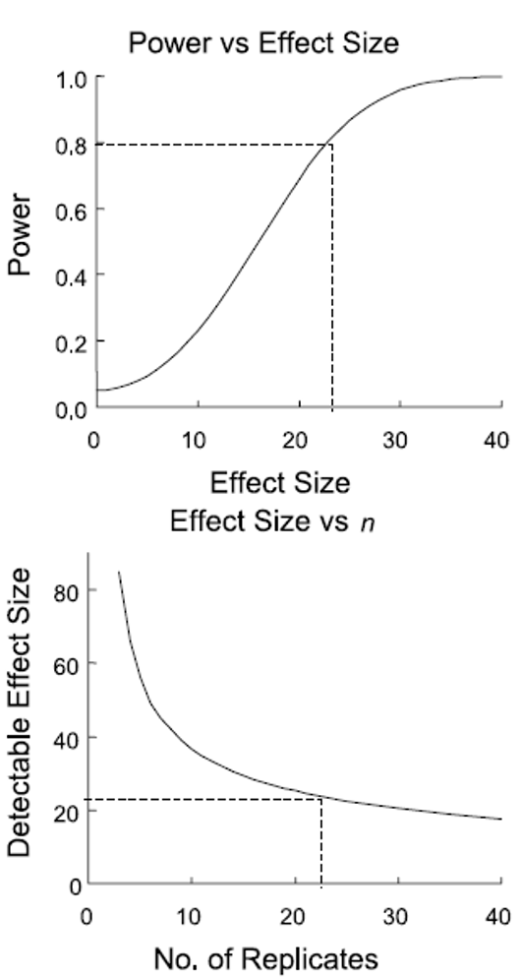
Study Design and Analysis
Study design is closely linked to statistical analysis
Recall: - Categorical vs. continuous variables - Dependent vs. independent variables
Nature of variables dictates analytical approach:
Match your analysis to your design
Cannot “fix” poor design with fancy statistics

Slide 35
Summary and Take-Home Messages
Key concepts we covered today:
Study design is critical - statistics cannot save poor design
Natural vs. manipulative experiments - different approaches to causality
Principles of good design:
Replication at the right scale
Proper randomization
Appropriate controls
Independence
Power analysis - planning for sufficient sample size
Match analysis to design - your statistical approach should follow from your experimental design
Remember:
Correlation ≠ causation
Beware of pseudoreplication
Design before you collect data
Consider practical constraints
Report everything transparently

Slide 36
References and Additional Resources
Gotelli, N. J., & Ellison, A. M. (2012). A primer of ecological statistics (2nd ed.). Sinauer Associates.
Hurlbert, S. H. (1984). Pseudoreplication and the design of ecological field experiments. Ecological Monographs, 54(2), 187-211.
Quinn, G. P., & Keough, M. J. (2002). Experimental design and data analysis for biologists. Cambridge University Press.
Zuur, A. F., Ieno, E. N., & Elphick, C. S. (2010). A protocol for data exploration to avoid common statistical problems. Methods in Ecology and Evolution, 1(1), 3-14.

